Slide 1







Reimagining College Events with Web 3 😊
College Life
Event Management
Web 3 Innovation
From orientation to graduation, events are a crucial part of the college experience.
But traditional event systems often face challenges with efficiency and engagement.
This presentation explores how Web 3 technologies can transform college events.

Slide 2

The Problem: Challenges with Traditional Event Systems
Traditional college event management is full of problems that make things difficult for both organizers and students. These problems lead to poor communication, disorganization, and concerns about the quality and security of events."
1
Issues with counterfeit tickets
2
Fragmentation of event information
3
Lack of student engagement
4
Data Security Concerns
5
Difficult for CLUBS to stand out

Slide 3


The Solution: Embracing Web 3 for Event Management
1
Decentralized Platform
2
Smart Contracts
A blockchain-based platform for event management offers a secure and transparent environment for all stakeholders.
Smart contracts automate key processes, such as registration, ticketing, and payments, reducing human error and improving efficiency.
3
NFT-Based Ticketing
4
Tokenized Rewards
NFT ticketing provides secure, verifiable, and unique tickets, eliminating the risk of counterfeiting and fraud.
Reward systems based on tokens incentivize participation and engagement, creating a thriving community.

Slide 4
Target audience :
1) College Students
2) College Clubs and Organizations
3) College Administrators

Slide 5
Feasibility and Scalability
Feasibility:
Technology Readiness: Uses widely adopted technologies like React, Node.js, and MongoDB, ensuring easy development and maintenance.
Development Resources: Leverages existing knowledge and frameworks, allowing for quick implementation and integration.
Cost-Effective: Minimal initial setup costs with scalable cloud hosting options; open-source tools reduce software expenses.
Scalability:
Modular Architecture: Designed with a modular structure, allowing individual components to be scaled independently based on demand.
Cloud Deployment: Utilizes cloud services (e.g., AWS, Azure) for on-demand scaling and resource management.
Database Scaling: Supports horizontal scaling with NoSQL databases like MongoDB, ensuring efficient handling of increased data volumes and user loads.
Performance Optimization: Implements caching, load balancing, and efficient database queries to handle growing user numbers and data.

Slide 6


Blockchain: Decentralized Management & NFT-Based Ticketing
Decentralized Management
NFT Ticketing
The blockchain's decentralized nature ensures transparency and accountability. All event data is stored securely and immutably, preventing manipulation and fraud.
NFTs offer unique, verifiable, and secure tickets. Each ticket is an asset on the blockchain, reducing the risk of counterfeiting and scalping.

Slide 7

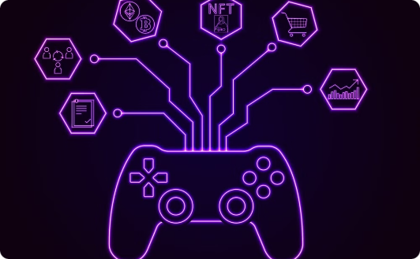

Benefits for College Communities: Increased Engagement, Efficiency, and Innovation
Increased Engagement
Improved Efficiency
Innovation & Collaboration
Tokenized reward systems and gamified experiences incentivize student participation and engagement in events.
Automation of key processes, such as registration and ticketing, streamlines event management and reduces administrative burden.
The Web 3 platform facilitates collaboration and innovation, empowering students to organize and host events that reflect their interests.

Slide 8
Technical approach :
we will be using three-tier architecture , This setup ensures scalability, maintainability, and a clear separation of concerns.
Frontend: HTML, CSS, JavaScript, React .
Backend: Node.js with Express .
Database: MySQL (SQL)
The combination of these components ensures a robust, scalable, and responsive application. The frontend handles the user experience, the backend manages application logic and communication, and the database stores critical data. This separation of concerns allows each layer to be developed, maintained, and scaled independently, ensuring a flexible and efficient development process.

Slide 9
Impact :
Enhanced Student Engagement
Streamlined Event Management
new model for clubs
Data-Driven Insights
Fostering a Connected Campus Community

Slide 10

Roadmap: Key Steps for Implementation
Phase 1
Develop a proof-of-concept for the Web 3 event platform.
Phase 2
Pilot the platform with a select group of college events.
Phase 3
Expand platform adoption across the college community.
Phase 4
Continuously improve the platform based on user feedback and data analytics.

